Slide 1

SATs KS1 – YEAR 2
We all matter

Slide 2
What are the SATS?
SATs are Statutory Assessment Tests
At the end of Year 2, children take SATs in:
Reading
English grammar, punctuation and spelling
Maths
No formal assessment for writing – evidence is gathered over the year.
Tests will take place during May

Slide 3
How are the SATs administered?
KS1 SATs don't have to be administered according to a nationally-set timetable in a specific week.
Schools are free to manage the timetable and will aim to administer the tests in the classroom in a low-stress, low-key way; some children won't even be aware they've taken them.

Slide 4
Reading
The reading test for Year 2 pupils is made up of two separate papers:
Paper 1 consists of a selection of texts totalling 400 to 700 words, with questions interspersed
Paper 2 comprises a reading booklet of a selection of passages totalling 800 to 1100 words. Children will write their answers in a separate booklet
Each paper is worth 50 per cent of the marks, and should take around 30 minutes, but children are not be strictly timed, as the tests are not intended to assess children’s ability to work at speed.
The texts in the reading papers cover a range of fiction, non-fiction and poetry, and get progressively more difficult towards the end of the test.
Teachers have the option to stop the test at any point that they feel is appropriate for a particular child.

Slide 5
Reading
There are a variety of question types:
Multiple choice
Ranking/ordering e.g. ‘Number the events below to show in which order they happened in the story’
Matching e.g. ‘Match the character to the job that they do in the story’
Labelling e.g. ‘Label the text to show the title’
Find and copy e.g. ‘Find and copy one word that shows what the weather was like in the story’
Short answer e.g. ‘What does the bear eat?’
Open-ended answer e.g. ‘Why did Lucy write the letter to her grandmother? Give two reasons’

Slide 6
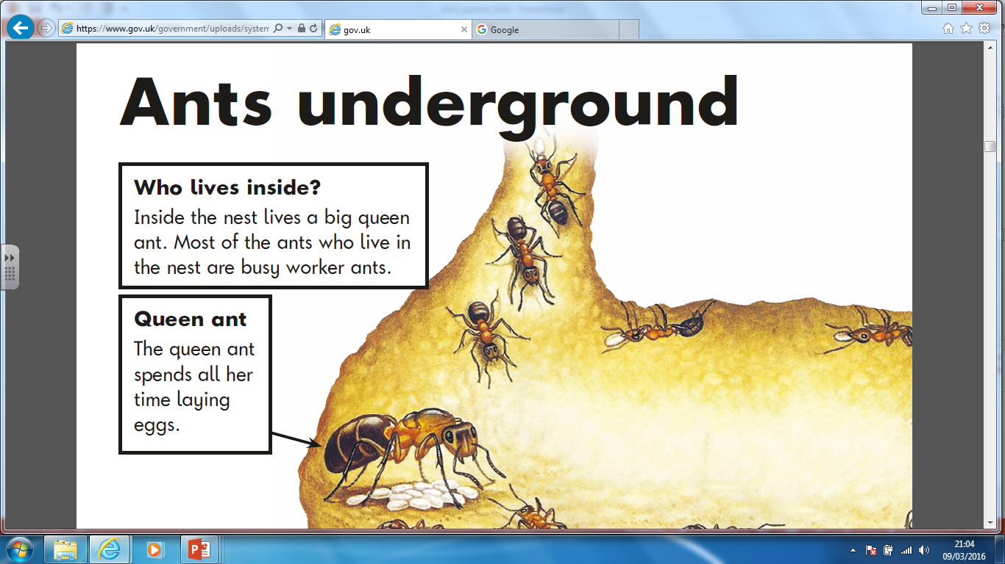
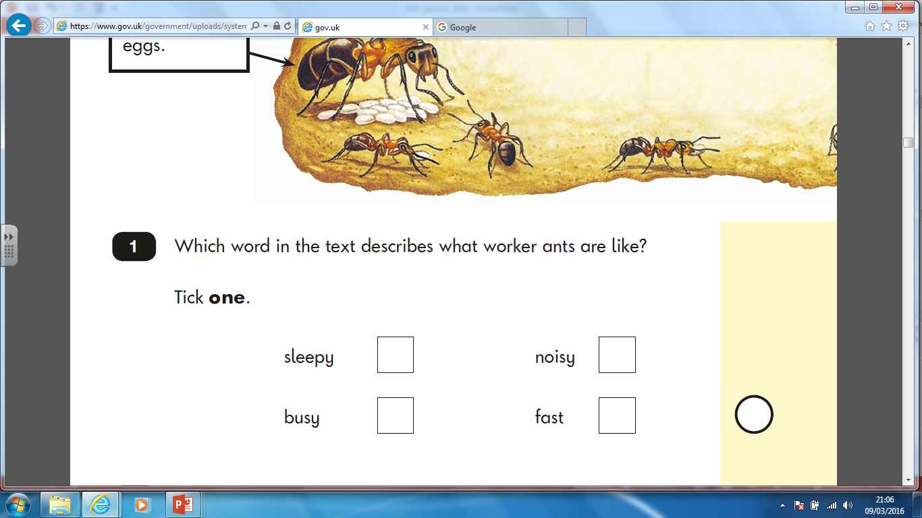

Slide 7
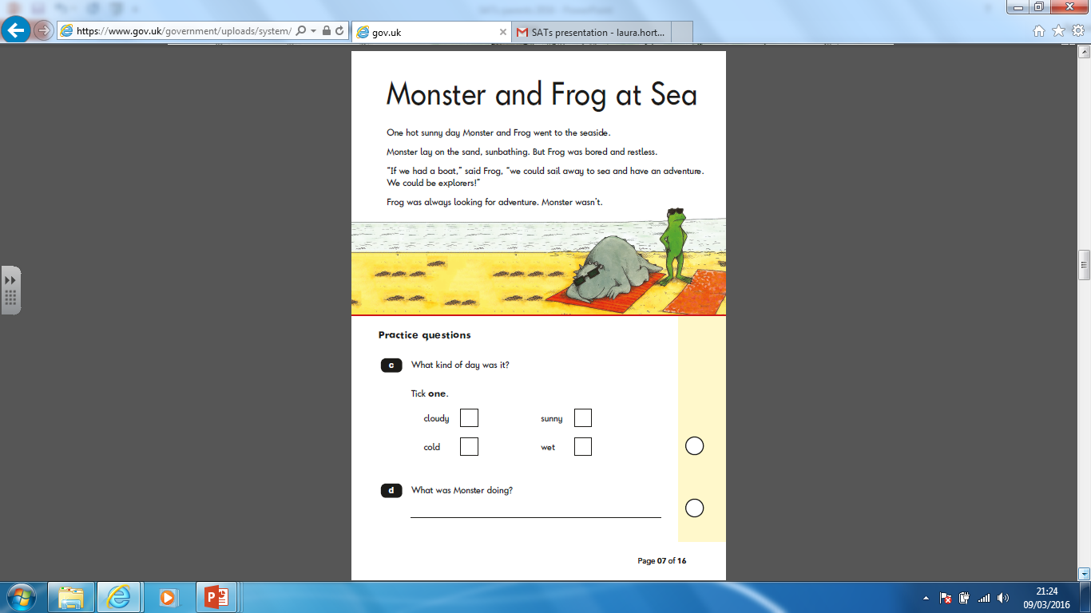

Slide 8
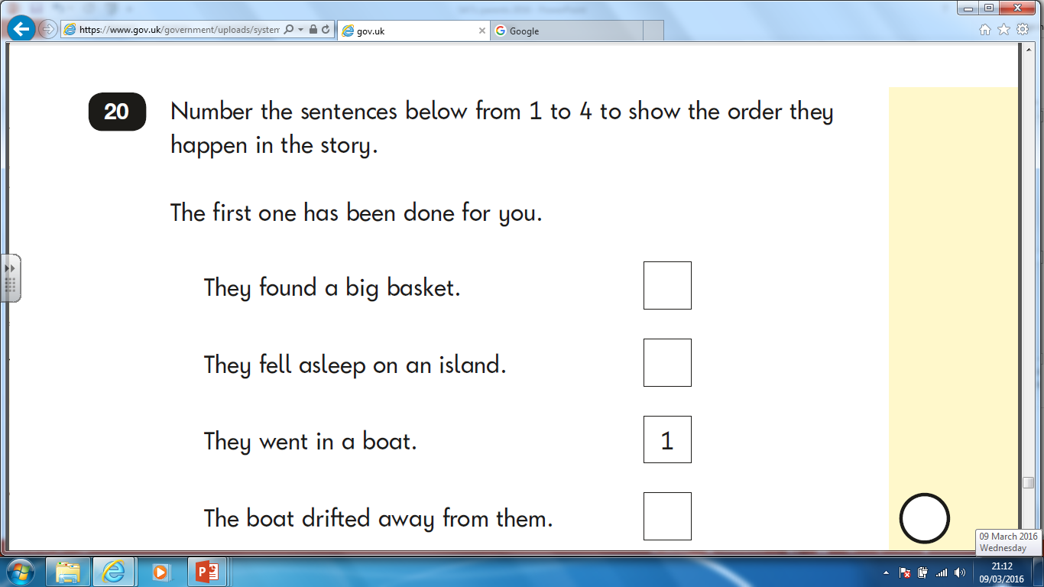

Slide 9


Slide 10
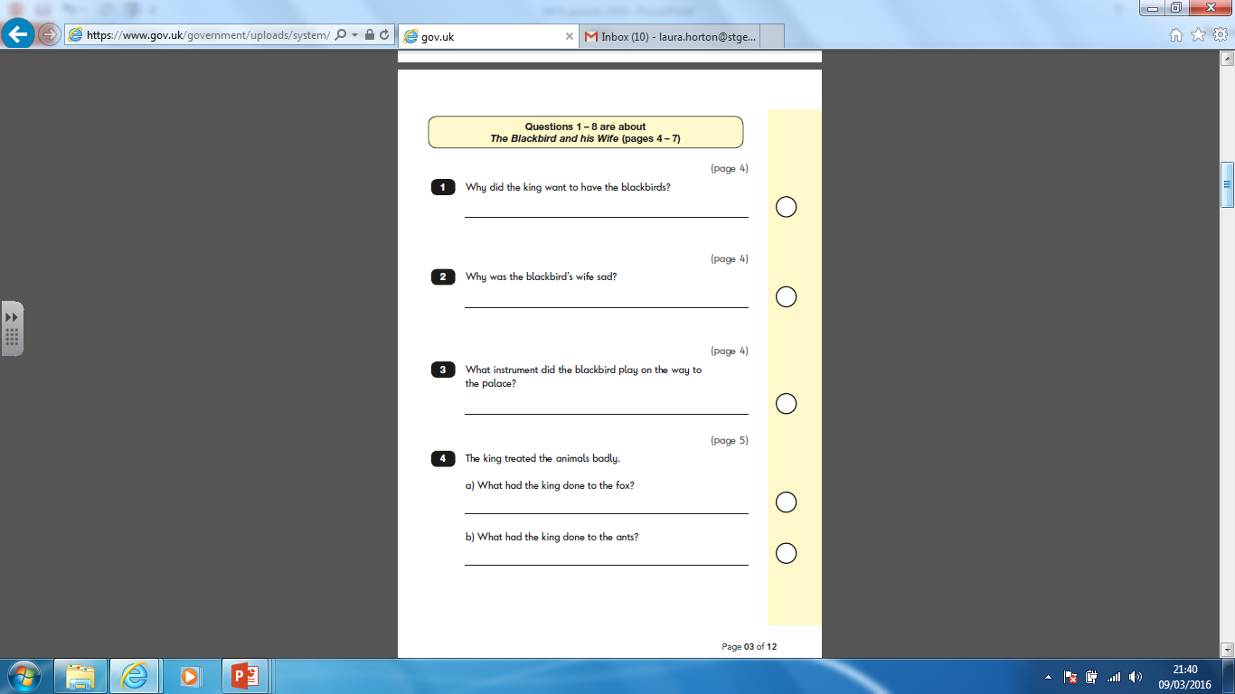

Slide 11
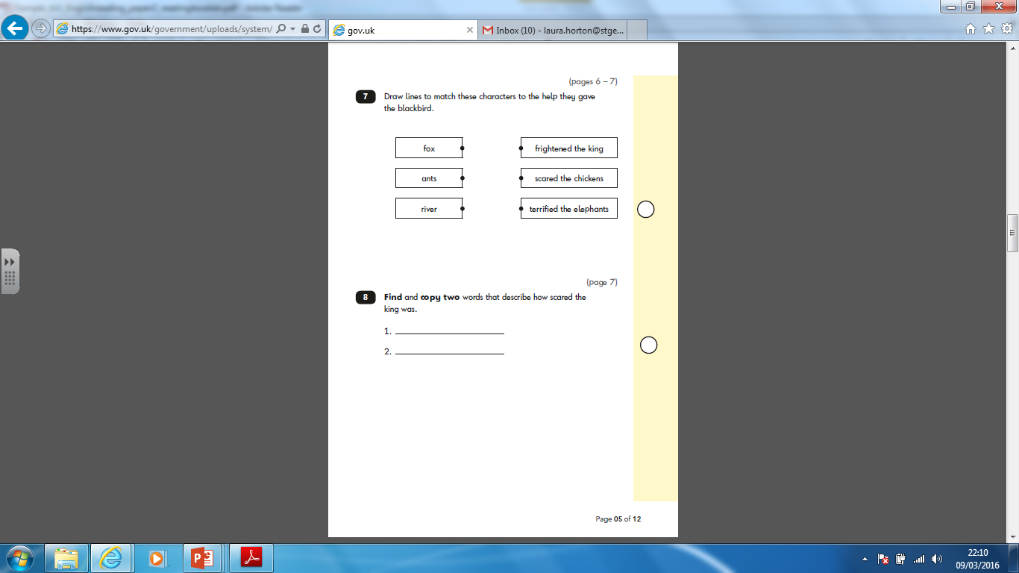

Slide 12
Grammar, Spelling and Punctuation (SPAG)
There are two separate papers in grammar, spelling and punctuation:
Paper 1: a 20-word spelling test taking approximately 15 minutes and worth 20 marks.
Paper 2: a grammar, punctuation and vocabulary test, in two sections of around 10 minutes each (with a break in between, if necessary), worth 20 marks. This will involve a mixture of selecting the right answers e.g. through multiple choice, and writing short answers.
In 2017 the KS1 SPAG test remains optional, so schools can choose whether to administer it to their pupils.

Slide 13
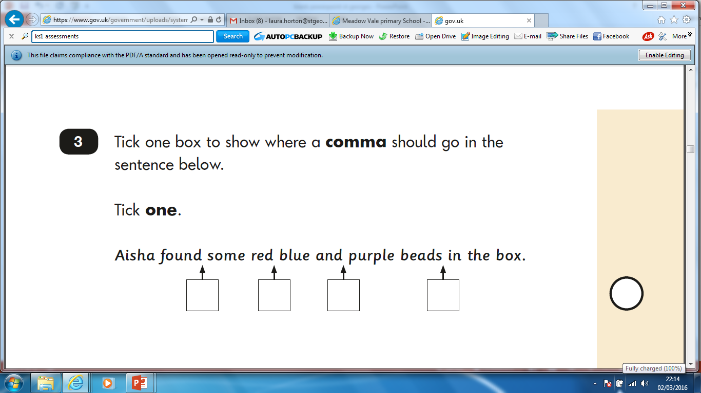

Slide 14
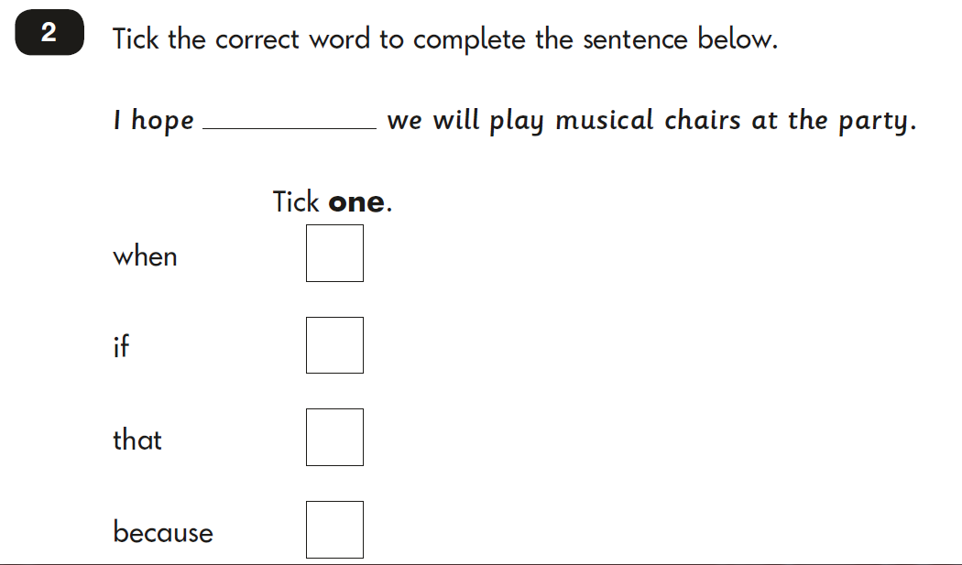

Slide 15
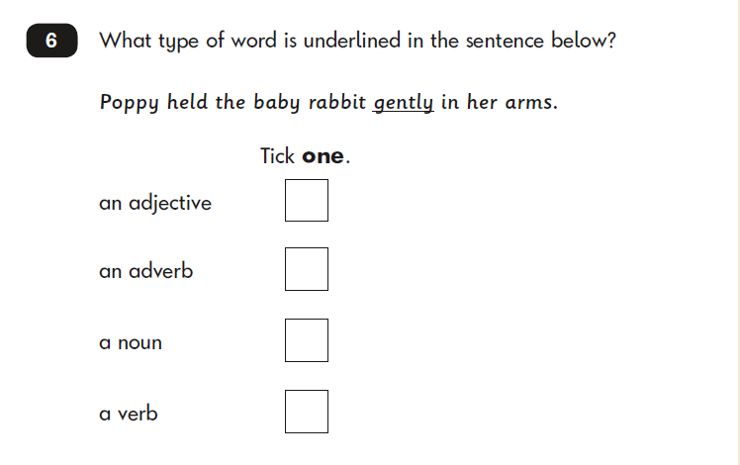

Slide 16
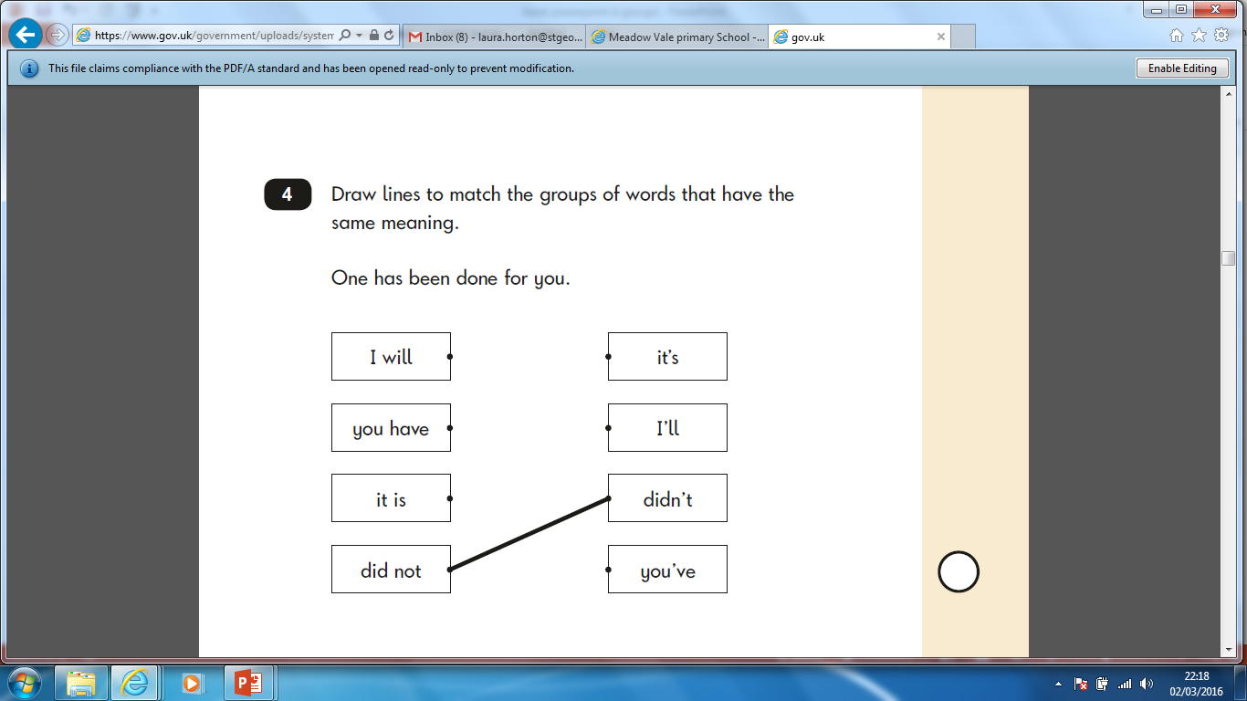

Slide 17
Maths
The Key Stage 1 maths test is made up of two papers:
Paper 1: arithmetic, worth 25 marks and taking around 15 minutes.
Paper 2: mathematical fluency, problem-solving and reasoning, worth 35 marks and taking 35 minutes, with a break if necessary.
There are a variety of question types:
multiple choice,
matching,
true/false,
constrained (e.g. completing a chart or table; drawing a shape)
less constrained (e.g. children have to show or explain their method).
Children are NOT allowed to use any practical resources

Slide 18
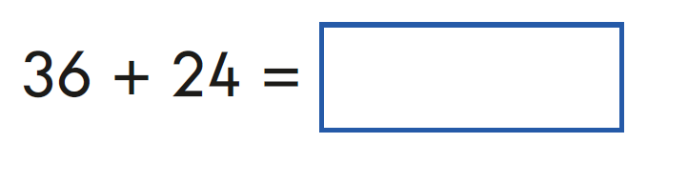
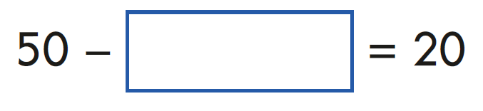
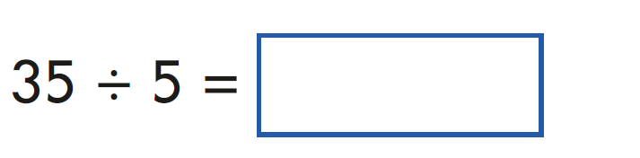
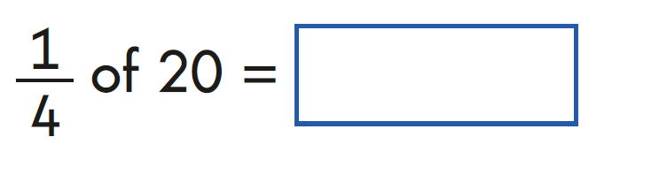
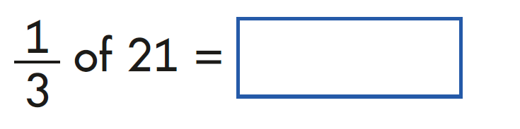
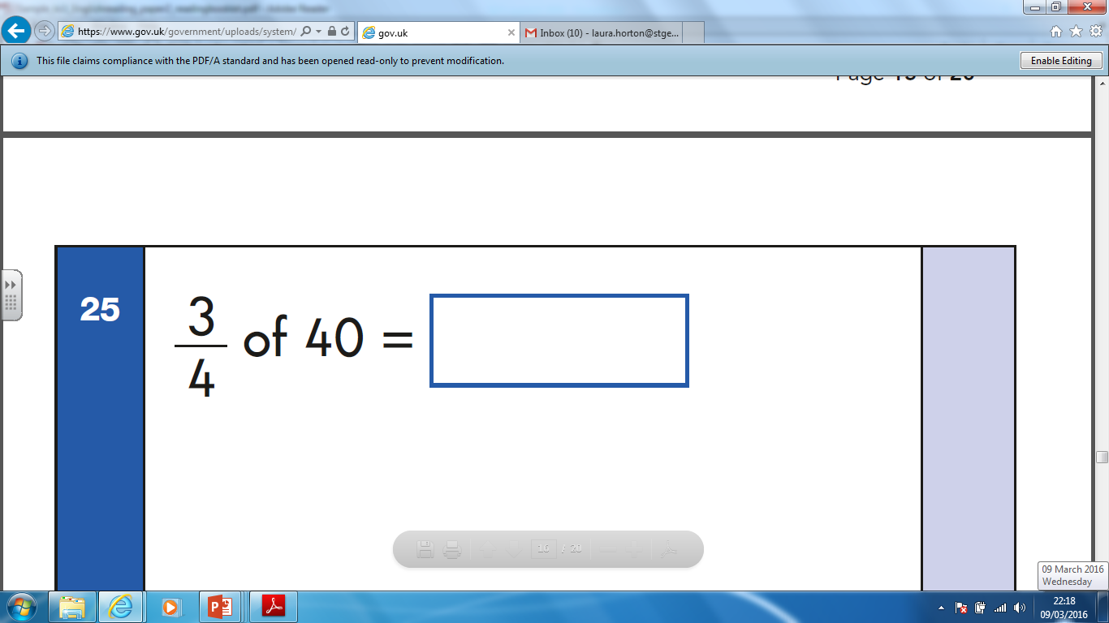
Paper 1 ~ Arithmetic test
This paper will test your child on their knowledge of the four operations - addition, subtraction, multiplication and division.
The questions are all in number sentences, with no word problems.

Slide 19
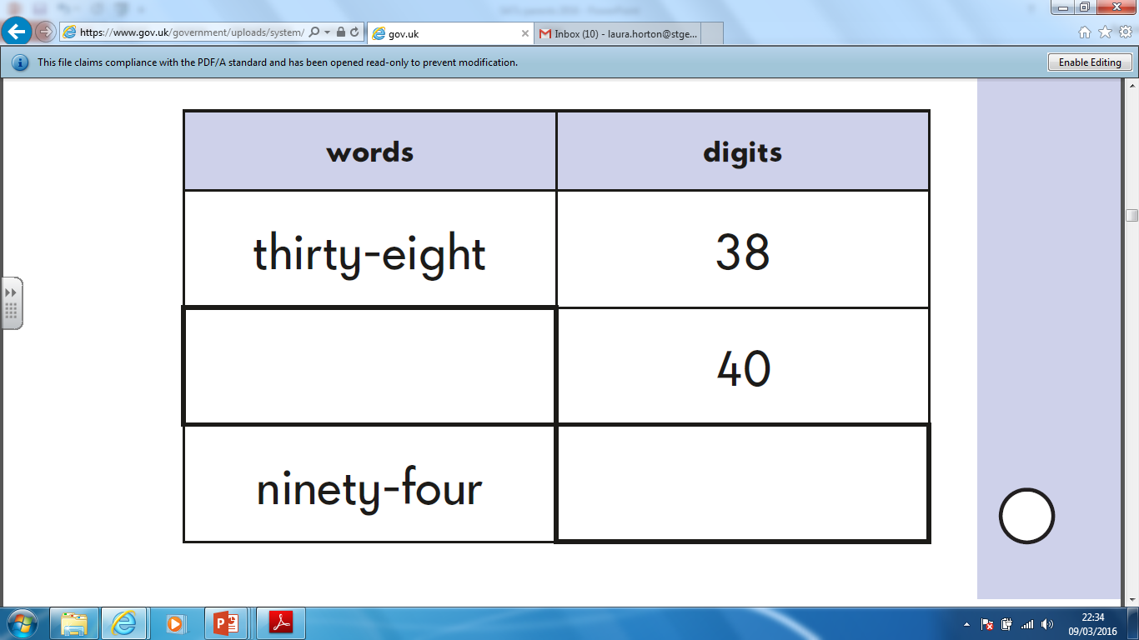
Paper 2 ~ Reasoning

Slide 20
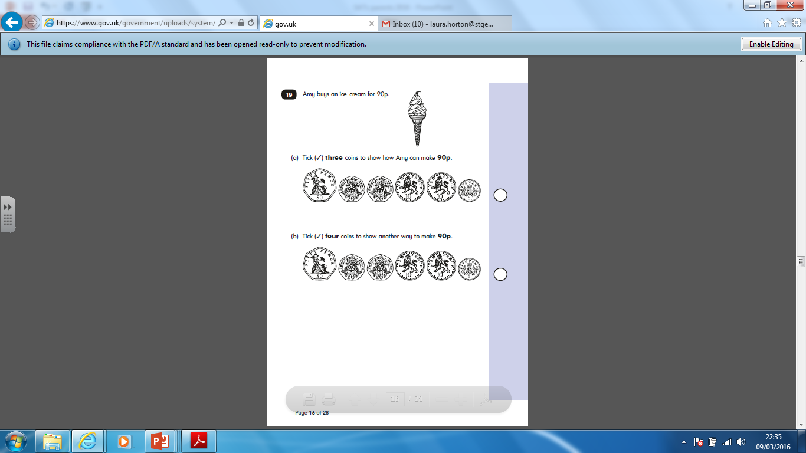

Slide 21
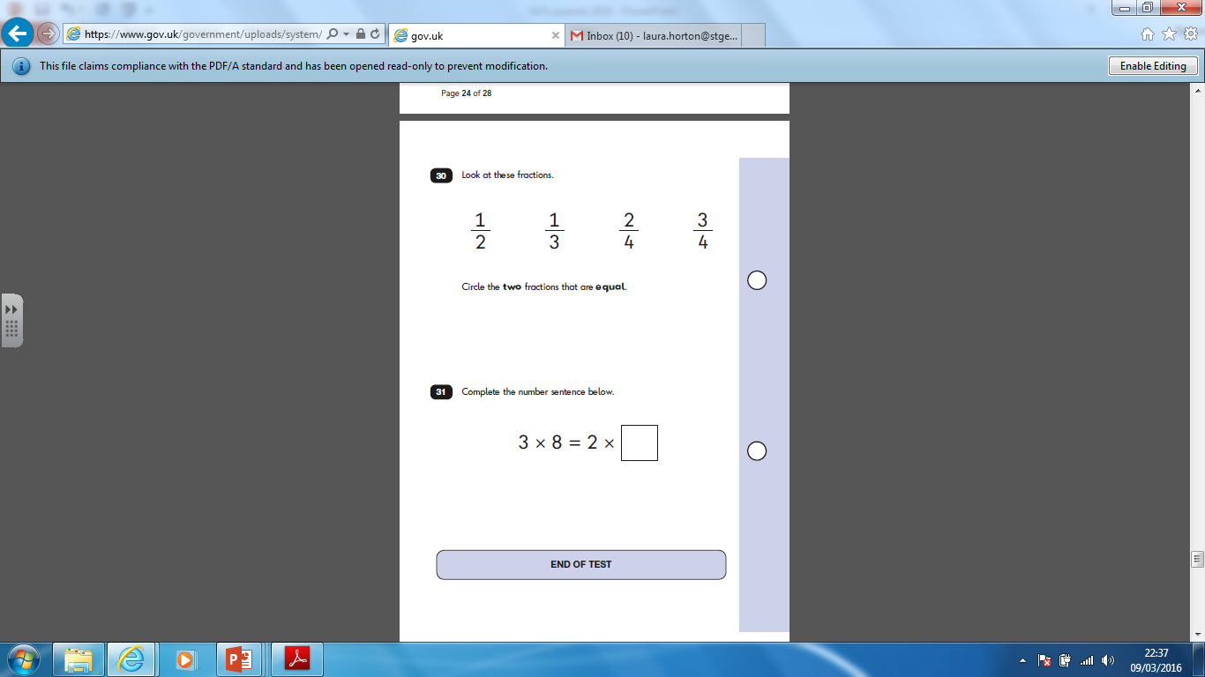

Slide 22
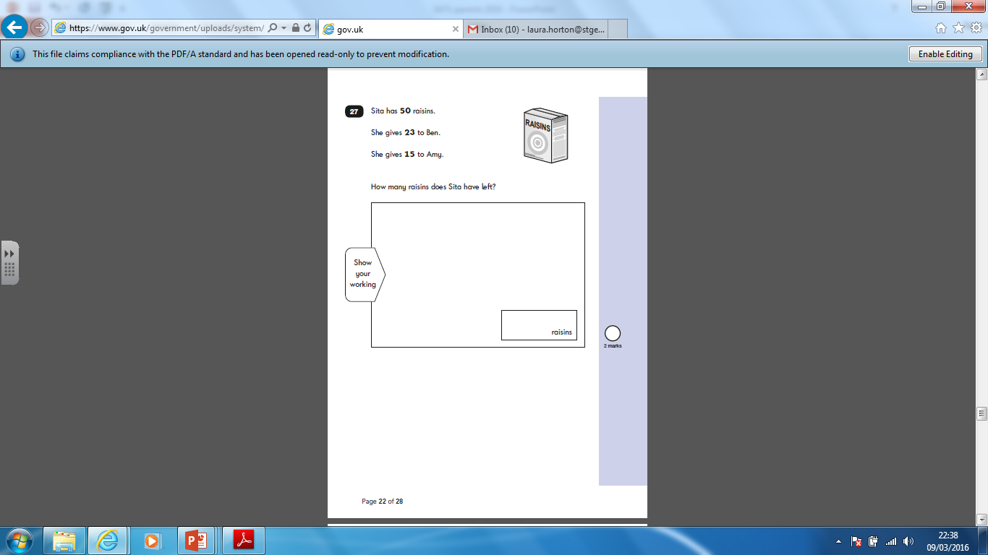

Slide 23
How will the tests be marked?
Tests are set externally but are marked by teachers within the school.
Children are given a scaled score.
What is meant by ‘scaled scores’?
Each pupil’s raw test score (number they got right) will be converted into a score
on a scale, either at, above or below 100.
100 will always represent the ‘national standard’.
The scale has a lower end point of 85 and an upper end point at 115.
A child who achieves the ‘national standard’ (a score of 100) will be judged to
have demonstrated sufficient knowledge in the areas assessed by the tests.
Teacher assessments are also used to build up a picture of your child’s learning and achievements.
Your child will also receive an overall result saying whether they have achieved the required standard in the tests.
The Department for Education aims for 85 per cent of children to reach the expected standard. This is a higher standard than was expected before 2016.

Slide 24
How do we help prepare your child?
High quality teaching and learning
Test language used in lessons and instructions
Guided reading – sample questions
SPAG in shared and guided reading and writing – sample questions
Spellings – weekly
Test type questions in maths
Mental Maths – practice in lessons

Slide 25

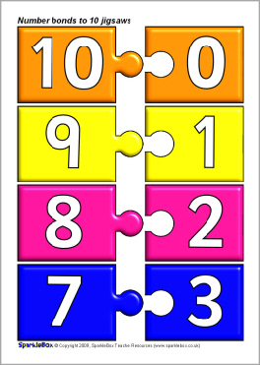



What can you do to help?
Good attendance
and punctuality

