Slide 1
‘I want to ride my bicycle’
The bicycle in art
https://www.youtube.com/watch?v=KwvWtZl2ICY

Slide 2
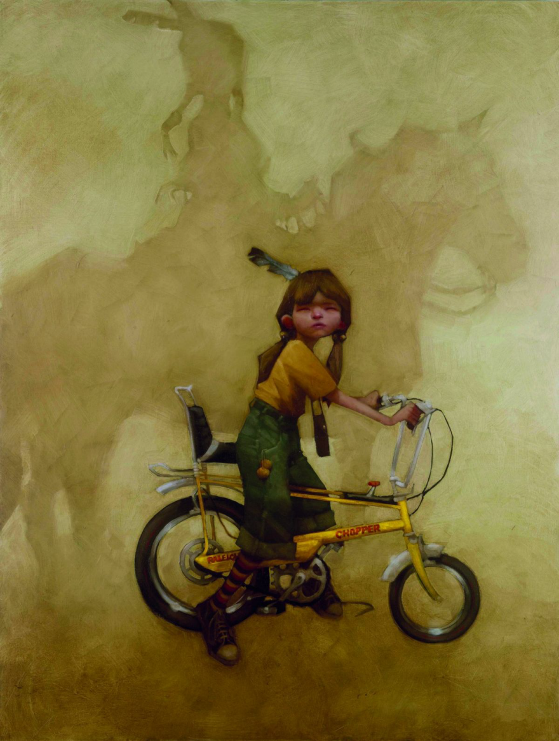
Craig Davison

Slide 3
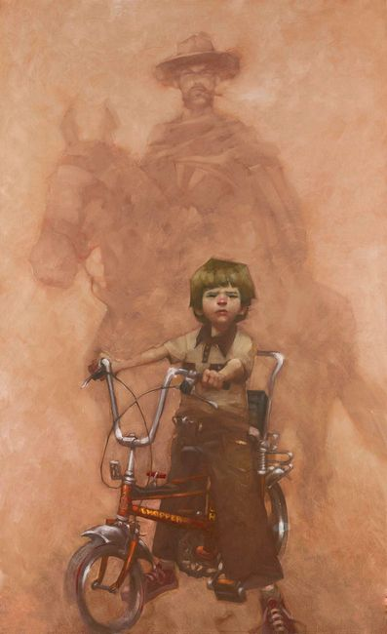
Craig Davison

Slide 4
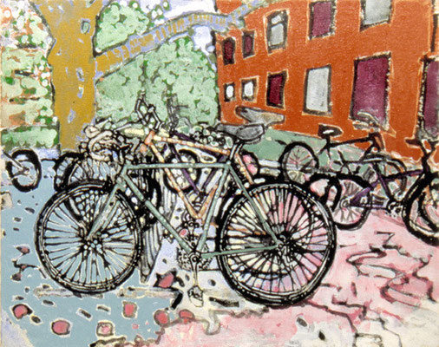
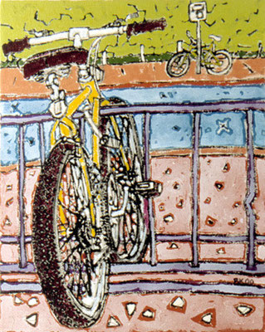
Brianna Keeper

Slide 5
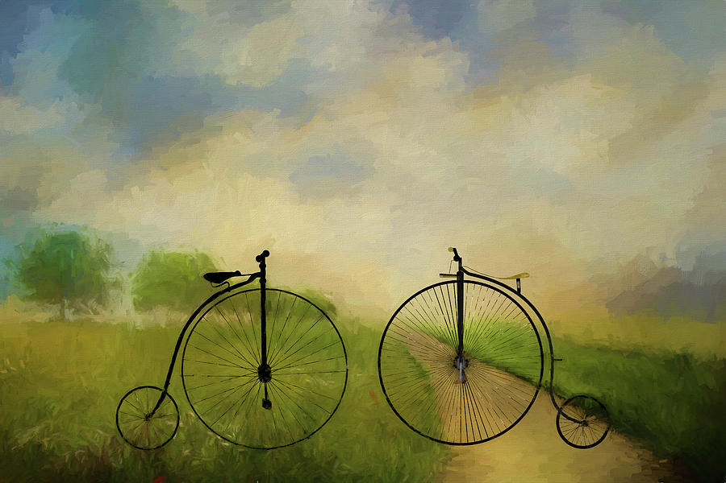
Ericamaxine Price

Slide 6
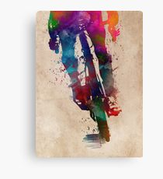

Slide 7
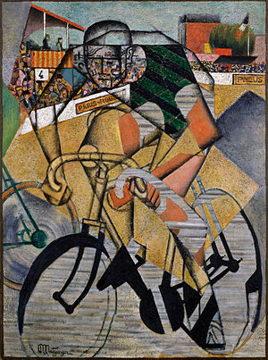
Jean Metzinger

Slide 8

Henri de
Toulouse-Lautrec

Slide 9
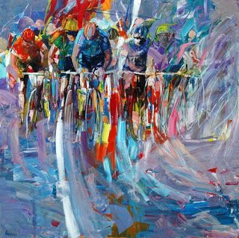
Antonio Tamburro

Slide 10
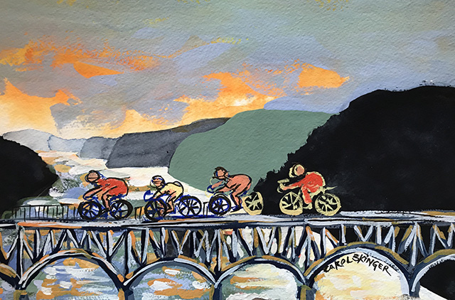
Carol Skinger

Slide 11
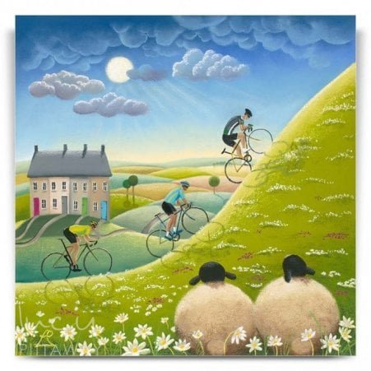
Lucy Pittaway

