Slide 1
Autumn
in art
https://www.youtube.com/watch?v=H7hGiZ579cs

Slide 2
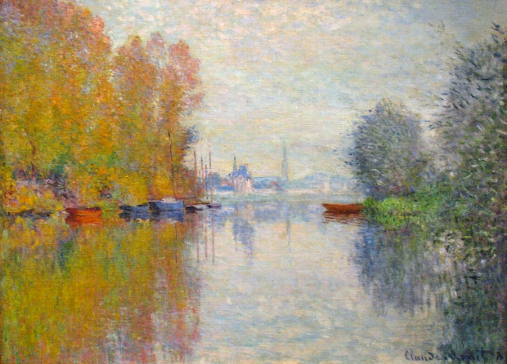
Claude Monet
Autumn on the Seine at Argenteuil

Slide 3
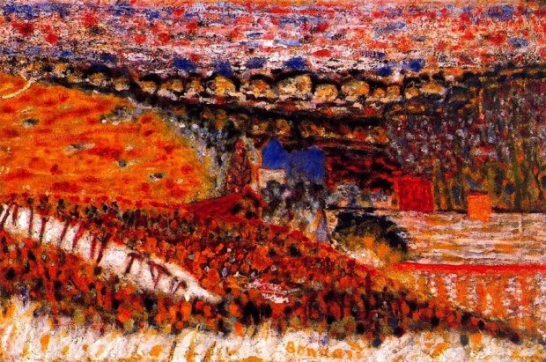
Pierre Bonnard
Autumn View

Slide 4
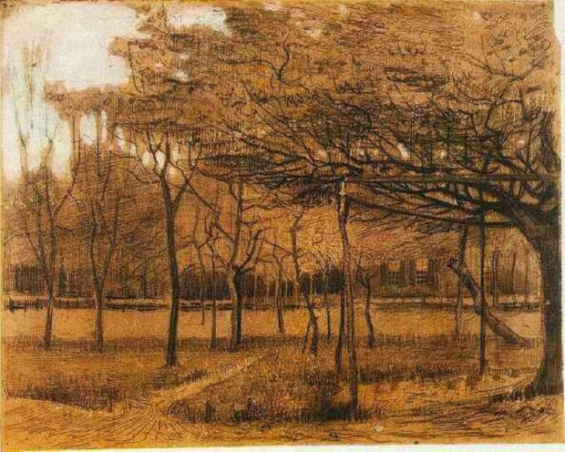
Vincent van Gogh
Landscape with Trees

Slide 5
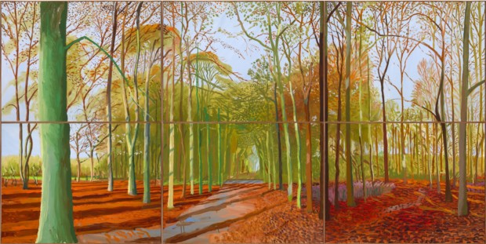
David Hockney
Woldgate Woods

Slide 6
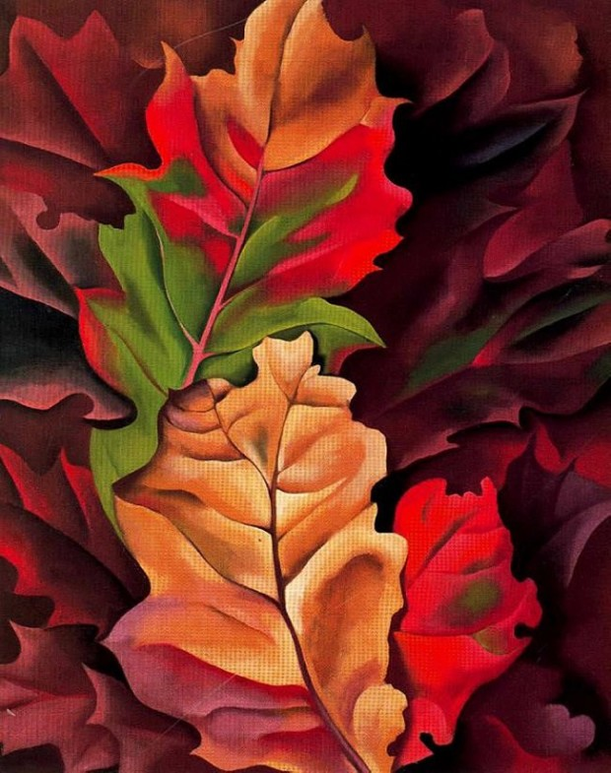
Georgia O’Keefe
Autumn Leaves

Slide 7
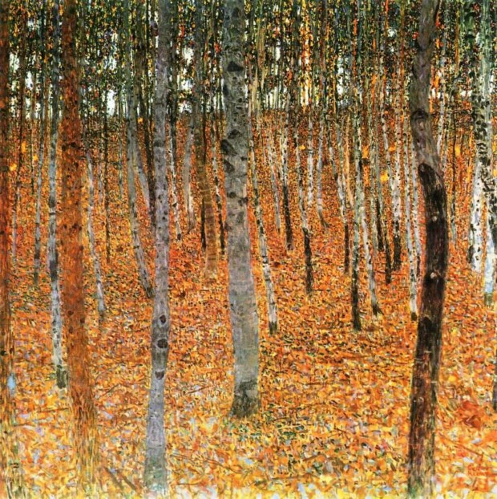
Gustav Klimt
Birch Forest

Slide 8
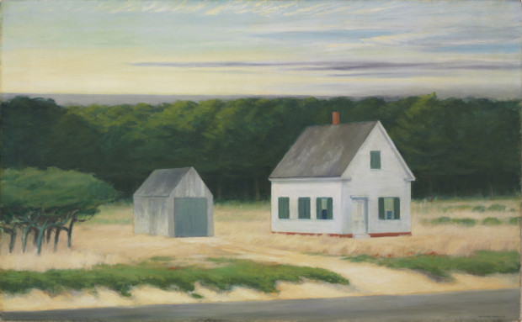
Edward Hopper
October on Cape Cod

Slide 9
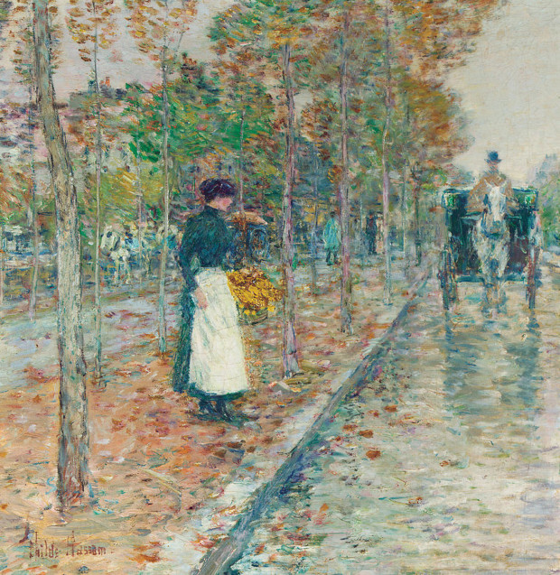
Childe Hassam,
Autumn Boulevard, Paris

Slide 10
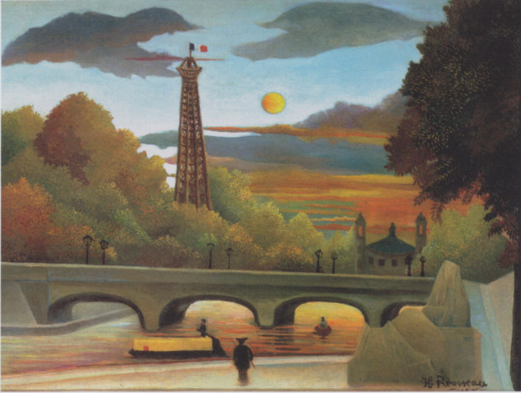
Henri Rousseau
Eiffel Tower at Sunset

Slide 11
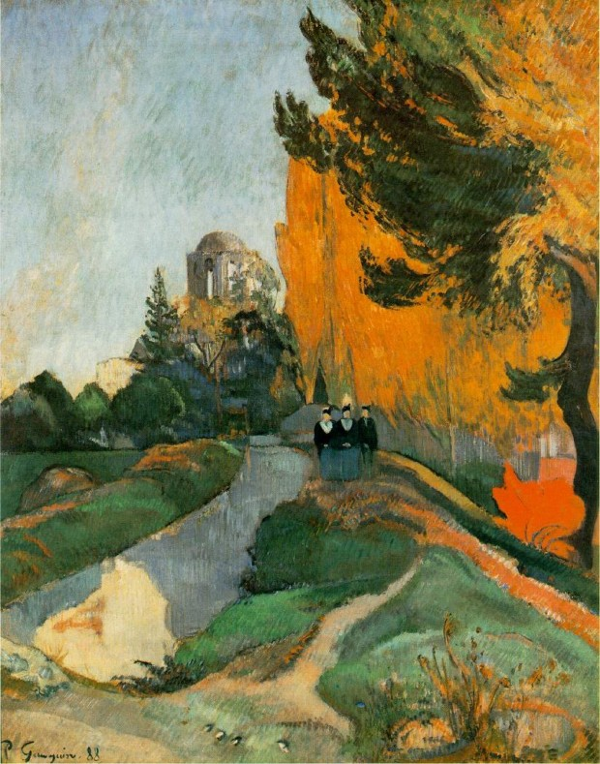
Paul Gauguin
Landscape in Arles near the Alyscamps

Slide 12
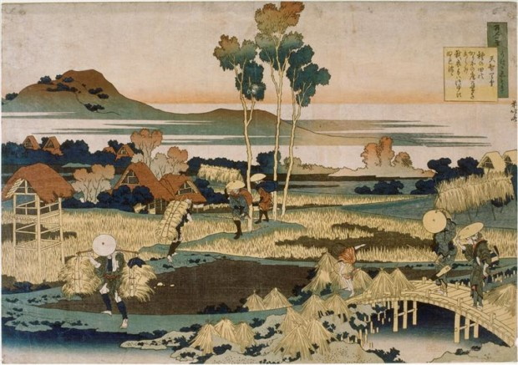
Katsushika Hokusai
Peasants in autumn

Slide 13
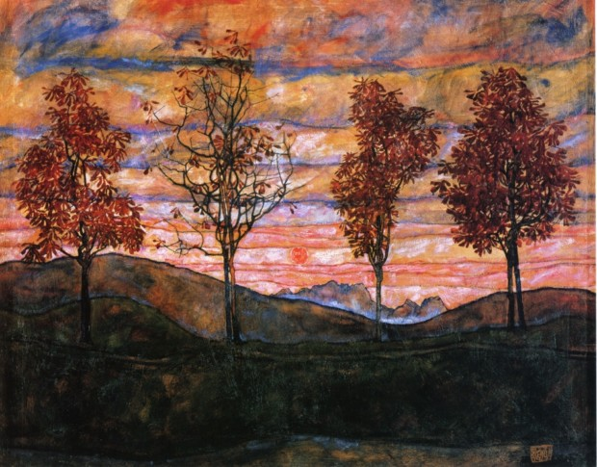
Egon Schiele
Four Trees

Slide 14
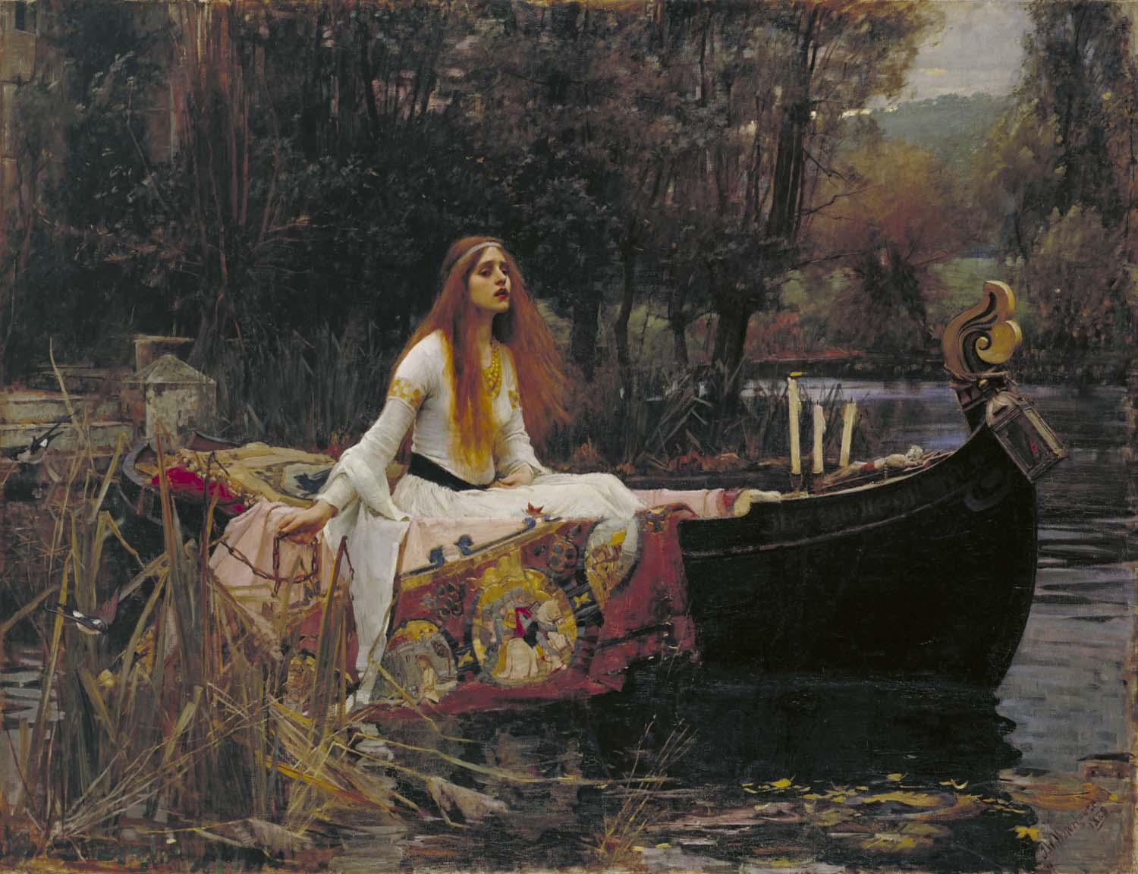
John William Waterhouse
The Lady of Shalott

Slide 15
Composer: Vivaldi
Composition: The Four Seasons
Piece: Autumn

