Slide 1
Wrenbury Primary School where ‘We all matter’
Mrs Heaton- Base 3
Pastoral meeting

Slide 2
Being ready for the school day
School uniform
Encourage independence / self organisation skills
Daily - Reading book and reading record
PE kits – Base timetables for sport
Water bottle – named (Only water please)
Homework in on day requested and why important
Letters/monies – ALL COME TO CLASS TEACHER

Slide 3
Uniform
Label everything please! …including coats, shoes and especially PE kit
Red jumper/cardigan in school every day
No jewellery or nail varnish.
Watches and stud earrings are acceptable (need to be removed during PE)

Slide 4
PE kit
PE is on Tuesday and Thursday this term, one session being led by Mr Booth (Sportscape). We may have additional lessons linked to our learning journey throughout the week so please ensure PE kits are in school everyday.
Indoor PE kit
Red t-shirt
Black shorts
Trainers/pumps
Outdoor PE kit
Red t-shirt
Dark sweatshirt
Dark jogging bottoms
Trainers (with a good grip)

Slide 5
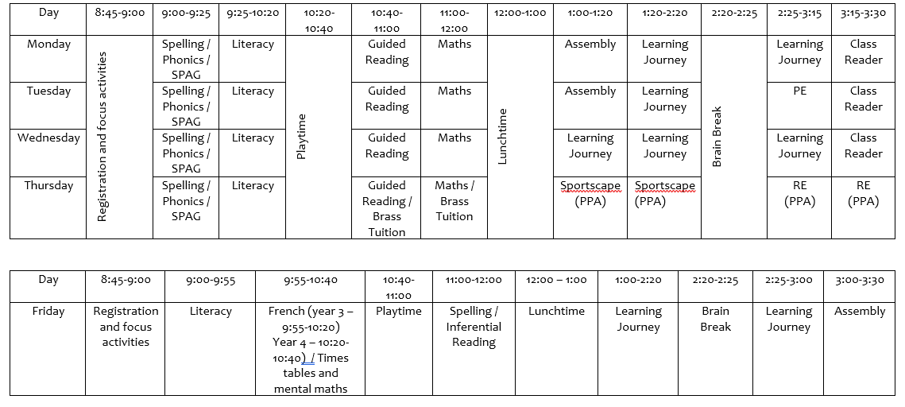

Slide 6
Meet and Greet
Prompt start to the day for all (8:45)
Any relevant information /concerns shared sooner rather than later (if not dropping off – call school or send in note with child)
Activities set up in class to engage children in learning
Supervision – TA in class to meet the children

Slide 7
Punctuality and attendance
Being on time – life skill, settle in with everyone, don’t have a sense of not knowing what is going on
Very important to be in school as much as possible
Miss learning and next steps, builds insecurity, gaps in knowledge, skills and understanding which in turn effects confidence

Slide 8
Curriculum
Planned around the class text where possible
Holistic plans
Whole school theme : Time Travellers
Year 3/4 theme – Romans Empire and its impact on Britain, using Escape from Rome, The Sandal and The Story of Romulus and Remus
Invasion and Conquest of Britain – Caesar and Claudius
Roman Empire by AD42
The power of the Roman Army
‘Romanisation’ of Britain
Italy – a study of a European Country
PE – 2 hours a week
French remains on a Friday with Madame Sharpe
RE will be taught by Mrs Clarke on Thursday afternoon

Slide 9
Literacy
Following the National Curriculum for year 3 and 4
Children will learn to:
Write at length with increasing stamina
Write in various styles
Explore and utilise different texts that will lead the writing
Develop writing ideas through discussions and role play
Develop impact of vocabulary choice through word activities and books
Develop their handwriting into a fluent cursive style
Develop their sentence structure within Literacy lessons and SPAG sessions
Learn to edit their own writing
Spellings and punctuation
Sentence structure and impact on writing
Paragraphs
Vocabulary

Slide 10
Spelling
Spelling investigations – explore the spelling being taught and apply it across different activities
Spelling test – Thursday, to test application of a rule and the words
Practice learning a few at a time and often. Don’t learn spellings night before test – often forgotten unless a child has a very good ability in retaining spellings – not many children can long term
Additional tasks given on spelling homework
Weekly spellings
5 – 10 words sent home weekly which focus on the spelling pattern we have been learning
Statutory spelling words
8 spellings sent home every 4 weeks – ticked off in the back of spelling books
Repetitive learning helps to embed the spelling

Slide 11
Reading
In Class
Daily guided reading sessions
Reading 1:1 with an adult where necessary
Wide range of reading activities to develop reading and comprehension skills
Reading will be integrated into all subjects
Range of books used in class
At home
Daily reading with and without and adult
Read a wide range of books alongside school reading book
Reading records to record when a child has read (both parents and child can write in these) – they will be checked daily
Cross the reading bridge!!

Slide 12
Maths
Following the year group’s NC
Important aspects:
Counting in multiples of 4, 8, 50, 100 (year 3) and 6, 7, 9, 25, 1000 (year 4)
Understanding place value H T O (year 3) Th H T O (year 4)
Times tables – Year 3: 2, 5, 10, 3, 4 and 8 times tables Year 4: all times tables up to 12 x 12
over-learn so they are really well embedded
All concepts will be developed and embedded through using a concrete, visual and abstract approach
Wide range of activities for the children to develop and embed concepts
Mental Maths will be practised throughout every day

Slide 13
Progress
Baseline children in reading, writing, maths, spelling and SPAG
Use information to target teaching for individuals, groups, whole class against end of year expectations
We track each child’s progress against end of year objectives
Parent progress meetings across year: share how child is getting on in school, strengths and what need to focus on.

Slide 14
Homework
Aims: to consolidate learning in class, practise skills or preparation for future learning e.g. research activity.
Literacy and Maths
Monday (Maths activity) - Completed by Friday
Thursday (usually Literacy based) – Completed by Tuesday
Times Tables -Test day Friday
To be practised at least 5 times throughout the week before the test.
Spellings -Test day Thursday
To be practised 5 times throughout the week before the test.

Slide 15
Playtime and Lunchtime
Morning
snack – from kitchen
healthy snack
Whole school out together – areas for different types of play, encourage activity
Lunch time – whole school have 1 hr for lunch
All eat at same time
Staff settle children
KS2 – larger climbing equipment – rota for each year group
Afternoon brain break is a short 5 mins break – fresh air, toilet and drink stop to fit in with the class learning.

Slide 16
Well being
We take well-being seriously
Important that information is shared between home and school – Meet and greet/notes
Family / pet bereavement, someone in hospital / unemployment, house move, parent split – ALL can impact on children even if not always obvious. Often children don’t want to upset the adult more by showing they are unhappy or worried.
Children can worry about school, work, friendships etc.
Worry Box in class – checked daily
A happy child learns best!

Slide 17
Well-being lunches
What do we want to achieve:
Let every child know they matter
Give every child a voice
Encourage self-belief and for each child to know that they have someone who believes in them
Build each child’s confidence to use their voice and share their problems
Give each child someone who will listen to them (other than their teacher/teaching assistant)
Make each child feel safe
Ensure each child enjoys the time they share together and have fun
Provide the children with strategies to ‘cope’ with difficulties
Each child is well-known to adult beyond the classroom
Build each child’s friendship groups across the school.
Meet for lunch in a group of 8/9 to have lunch with another adult who will be their ‘mentor’
Autumn term theme – emotions and feelings

Slide 18
Home time arrangements
Keeping your child safe
Must let school know if usual arrangements have changed and a different adult is picking your child up
If you know you could be late and if it is possible ring to let us know
We can’t just let a child go!

Slide 19
Parent partnership
Teacher – child – parent
Good parent partnership offers the best outcomes for the child
Working together
Supporting the learning process at home and in school

Slide 20
Any concerns…
Come and share
How:
Meet and Greet
Note/letter to teacher
Make an appointment for a mutually convenient time
Phone call if can’t get into school (arrange time with Debbie when both teacher and self are free)
Appointments to see Mrs Cador

Slide 21
Thank you! Any questions?

